Slide 1
{ "_id" : "PYCON_INDIA_2017", "talks" : [ { "speaker" : "Ankur Raina", "topic" : "PyMongo - Learn Python-MongoDB driver from scratch",
"datetime" : ISODate("2017-11-02T16:30:00Z"), #will be replaced by actual date-time },
{
...
} ], "place" : { "name" : "CONVENTION CENTER JNU", "where" : "Jawaharlal Nehru University, New Delhi, India", "city" : "New Delhi", "state" : "New Delhi", "pincode" : "110067", "map" : { "google" : "https://goo.gl/maps/97r87GaGue32", "coordinates" : [ 28.5127406, 77.1740096 ] } }, "event_website" : "https://in.pycon.org/2017/index.html", "event_sponsor" : "Regus Spaces" }

Slide 2
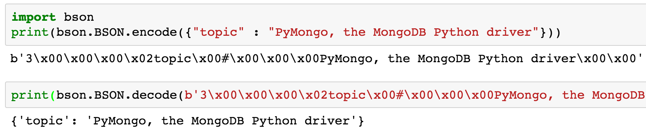
BSON
bin­ary-en­coded seri­al­iz­a­tion of JSON
http://bsonspec.org/

Slide 3
Wire Protocol
TCP/IP Socket
OP_INSERT, OP_UPDATE, OP_DELETE
OP_KILL_CURSORS
OP_QUERY, OP_GET_MORE <- OP_REPLY
OP_MSG

Slide 4

PyMongo Driver
MongoDB Python Driver
Open-Source
Python distribution containing tools for working with MongoDB
https://api.mongodb.com/python/
pip install pymongo
Notes:
Don’t take the meme seriously!

Slide 5
MongoClient
Client for a MongoDB instance, a replica set, or a set of mongos processes.
class pymongo.mongo_client.MongoClient(host='localhost', port=27017, document_class=dict, tz_aware=False, connect=True, **kwargs)

Slide 6
Connection, CRUD & Aggregation
Demo through Jupyter

Slide 7


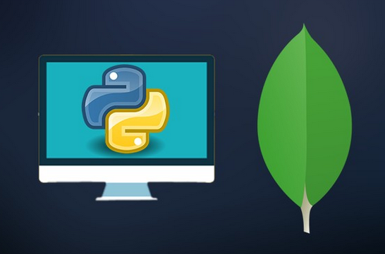
REPLICASET
MEMBER
Monitor: isMaster
REPLICASET
MEMBER
Monitor
MongoClient()
REPLICASET
MEMBER
Monitor

Slide 8
REPLICASET
MEMBER
heartbeatFrequencyMS
REPLICASET
MEMBER
MongoClient()
REPLICASET
MEMBER

Slide 9
REPLICASET
MEMBER
heartbeatFrequencyMS
REPLICASET
MEMBER
MongoClient()
Server Description / Topology Description
REPLICASET
MEMBER

Slide 10

REPLICASET
MEMBER
Fast Heartbeats
REPLICASET
MEMBER
MongoClient()
REPLICASET
MEMBER

Slide 11
AND THE LIFE GOES ON…
REPLICASET
MEMBER
POSSIBLE PRIMARY
TOPOLOGY/SERVER DESCRIPTION
REPLICASET
MEMBER
SEED1
MongoClient(SEED1, SEED2)
DISCOVERS SECONDARY
isMaster – with address of Primary
TOPOLOGY TYPE: UNKNOWN
RTT is also recorded
REPLICASET
MEMBER
SERVER DESCRIPTION – POSSIBLE PRIMARY
LAST UPDATE – INFINITY AGO

Slide 12
Handle Errors
PyMongoError (Base class for PyMongo exceptions)
Network/Connection Errors (AutoReconnect, NetworkTimeout, ServerSelectionTimeout, ExceededMaxWaiters, NotMasterError, ProtocolError, etc.)
Operation Errors (WTimeoutError, WriteConcernError, WriteError, BulkWriteError, DuplicateKeyError, ExecutionTimeout etc.)
Others

Slide 13
New Driver Features (Upcoming)
Wire Protocol Compression
Sessions
Retryable Writes
Causally Consistent Reads
Notification API

Slide 14
Questions?
I hope you enjoyed this session!

